Slide 1

Presentation on Major Project Progress
Guided By-
Asst. Professor Arzoo Pandey
Group Members-
Abhishek Baghel(02)
Anchal Nagwanshi(07)
Pratik Kujur (34)

Slide 2
CAR CRASH DETECTION USING DEEP LEARNING

Slide 3
Content
Problem Statement
Literature Survey
Flow Chart
Data Collection
Data Preprocessing
CNN Model

Slide 4
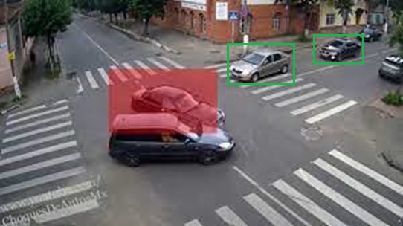
Problem Statement
Traditional traffic monitoring system in designed only to monitor traffic or to control the traffic, but it does not provide any solution to decrease the fatal accidental human damages rate which occur due to lack of medical aid in real time.

Slide 5
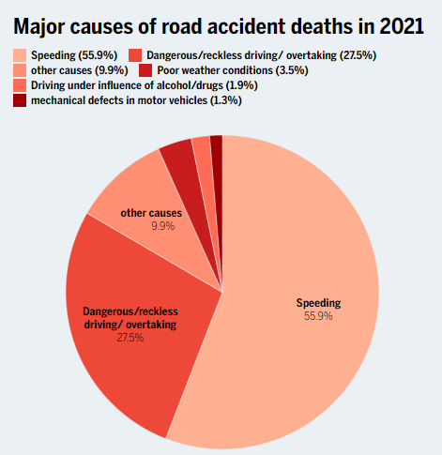
Major causes of road accident deaths in 2021

Slide 6
Literature Survey
Deep Learning applied to Road Accident Detection with Transfer Learning and Synthetic Images by Tiago Tamagusko et al.: The author discussed the idea of using synthetic images for training the CNN model due to the lack of CCTV footages with the help of transfer learning. These synthetic datasets can then be used to train deep learning models, such as convolutional neural networks (CNNs), which can learn to recognize patterns and features in the images that are relevant to the task at hand.
Deep learning for image classication: a survey.: The paper discusses the use of deep learning in image classification, where deep neural networks such as CNNs have been successful in achieving high performance. There are many pre-trained models for deep learning in image classification, including: VGG (Visual Geometry Group)16,Resnet, MobileNet models etc.

Slide 7
Data Collection
The dataset is combination of real car crash images and synthetic car crash images which are collected from YouTube. And overall, it comprises 5,000 photos sorted into two categories: training (4,000 images), and testing (1000 images).
Real car crash images Dataset: This dataset includes real car crash which are caught on CCTV camera. It comprises 1,000 photos sorted into two categories: training (800 images), and testing (200 images).
Synthetic car crash images Dataset: This dataset includes synthetic car crash images (4,000 images). Synthetic images are digital images that are generated by a computer rather than captured by a camera or other imaging device. These images are typically created using software that simulates the appearance of real-world objects, surfaces, and lighting conditions. It comprises 4,000 photos sorted into two categories: training (3200 images), and testing (800 images).

Slide 8
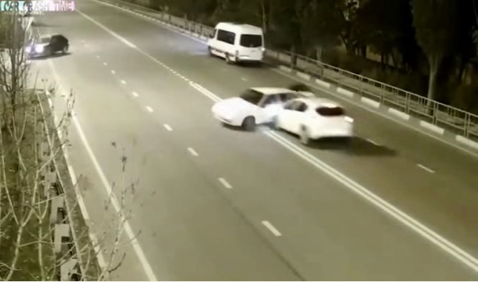
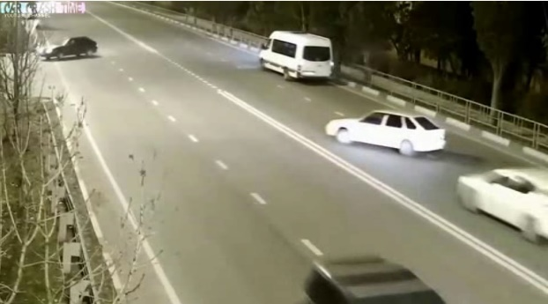
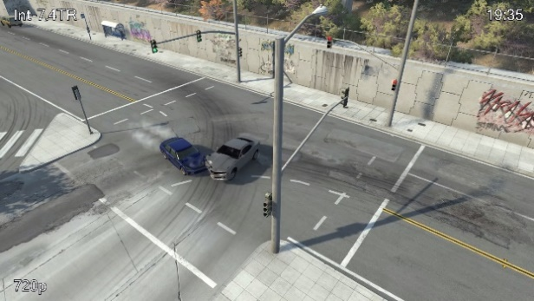
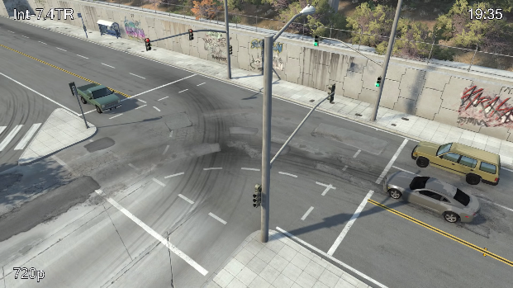
Crash
Not Crash
Crash image
Not Crash image
Synthetic Crash image
Synthetic Not Crash image

Slide 9
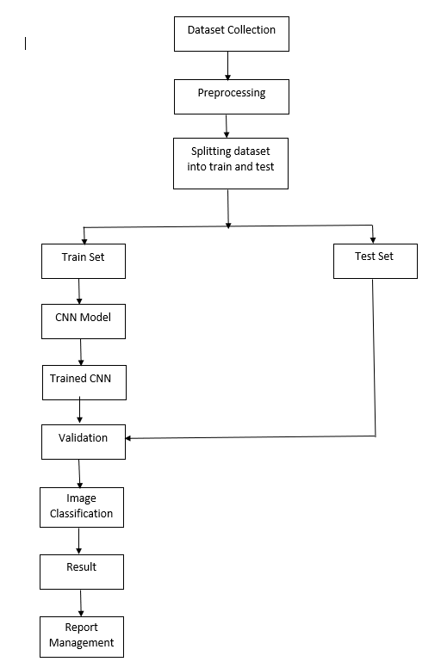
METHODOLOGY

Slide 10
Data Preprocessing
Resizing-
Resizing is often necessary because images in a dataset may have different sizes or resolutions, which can make it difficult to train the model.
The dimensions of images were of 1920 X 1080 (1920 pixels width and 1080 pixels height) before resizing. And after resizing images are of size 224 X 224 (224 pixels width and 224 pixels height).
Normalization-
Normalizing the input data helps to ensure that the model trains faster and converges to a better solution by improving the numerical stability of the optimization algorithm.
Data Augmentation-
Data augmentation is a machine learning approach that generates new training examples from existing ones to enhance the size of the training dataset.

Slide 11
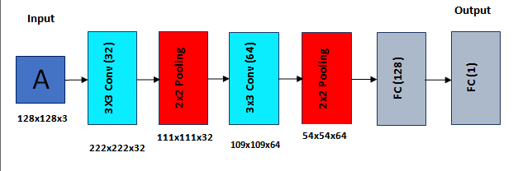
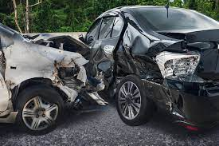
CNN Model
224x224x3

Slide 13
THANK YOU

